Slide 1

Shell Basics
Miroslav Biňas
(c) 2010 - 2013
Notes:
53 min (3)

Slide 2


Role of Command Shell
shell is piece of software that provides an interface for users of OS
command language interpreter
not part of system kernel, but uses system kernel for particular operations
many types of shells
  list of available shells in the system is in file /etc/shells

Slide 3
Communication Channels I.
communication channel (standard stream) - preconnected input and output between computer program and its environment (terminal)
three channels (streams)
  standard input (stdin)
  standard output (stdout)
  standard error (stderr)

Slide 4
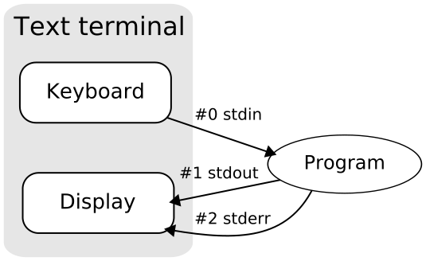
Communication Channels II.

Slide 5
File Redirection
standard streams can be redirected from their origins
standard input redirection
$ cmd < /path/to/file
standard output redirection
$ cmd > /path/to/file
$ cmd 1> /path/to/file
$ cmd >> /path/to/file
standard error redirection
$ cmd 2> file
$ cmd > file 2>&1

Slide 6
Piping Commands Together I.
piping - output of one process can become input for another
is done through '|' character (pipe)
syntax: $ CMD1|CMD2|..|CMDn
example:
$ ls | less
$ cat /etc/passwd|grep sh|less

Slide 7
Piping Commands Together II.
tee - read from standard input and write to standard output and files
options:
  -a - append
example:
$ bash|tee -a output.txt

Slide 8
Filename Matching
pattern matching
common formats (wildcards):
  * - matches zero or more characters, e.g. foo*ba* matches fooba, football, ..
  ? - matches any single character, e.g. ab.? matches ab.a, ab.1, ..
Notes:
file globbing and wildcard patterns

Slide 9
Brace Expansion
brace expansion - special mechanism, by which arbitrary strings may be generated
{n1,n2,n3} - matches any of the listed strings, e.g. file.{jpg,png} matches file.jpg and file.png

Slide 10
Shell/Environment Variables I.
every process runs in specific environment
environment consists of table of environment variables
  initialized during login
shell variables are internal variables - local to the shell, in which they are defined
to list all environment variables use env or printenv command
bash doesn't distinguish between environment and shell variables

Slide 11
Shell/Environment Variables II.
to set environment variable:
$ VAR=key
to unset environment variable:
$ unset VAR
to print value of environment variable:
$ echo $VAR
export VAR

Slide 12
Key Environment Variables
$HOME - home dir of current user
$PATH - the search path for the commands, colon separated
$SHELL - full path to the shell
$PWD - working directory
$USER - current user
$USERNAME - username of current user
$LANG - locale settings
Notes:
ukazat vyznam PATH pomocou:
PATH=

Slide 13
General Quoting Rules I.
metacharacters - characters with special meaning
$ echo * $HOME
escaping - canceling of all metacharas (escape character - backslash '\')
  -e - enables backslash escapes
$ echo -e \* $HOME
See man echo

Slide 14
General Quoting Rules II.
single quotes ' ' - cancel the meaning of all metachars except the backslash
$ echo -e ’\* $HOME’
Výstup
\* $HOME
double quotes " " - weakest quotes, but cancel most of the special meaning of the enclosed characters except '|', '\' and variables $VAR
$ echo -e "\* $HOME”
Výstup
\* /home/julius
Notes:
Funguje aj
echo -e \\n
Pre vypis noveho riadku

Slide 15
Nesting Commands
with back quotes ` ` - execute enclosed command
$ echo aktuálny čas je `date`
with $() - execute enclosed command echo $(date)
Try to display time in format HH:MM:SS using date and format string
date +%H:%M:%S
Notes:
echo nas cas je $(date +%X)

Slide 16
Multiple Commands
cmd1;cmd2;cmd3 - commands are run in sequence regardless of success of the previous command
cmd1 && cmd2 && cmd3 - each command will executed only if the previous exit code is 0 (success)
cmd1 || cmd2 || cmd3 - the next command will executed only if the previous exit code is not 0 (failure)
Notes:
echo "start" && echo "stop"
echo "start" && false && echo "stop"
echo "start" || echo "stop"
true || echo "hello"
false || echo "hello"

Slide 17
Multi-line Commands
to write command on several lines, use backslash '\' as line separator
example:
$ echo This text is\
written on several lines\
because its little bit\
longer :-\)

Slide 18
Správa procesov
Zobrazenie bežiacich procesov
ps -l vypíše procesy aktuálneho používateľa aj s detailami
ps –f - Display the uid, pid, parent pid, recent CPU usage, associated command.
ps aux - vypíše procesy aj ostatných používateľov
Zasielanie signálov alebo ukončenie procesov
kill –signal PID
1 HUP (hang up)
2 INT (interrupt)
3 QUIT (quit)
6 ABRT (abort)
9 KILL (non-catchable, non-ignorable kill)
14 ALRM (alarm clock)
15 TERM (software termination signal)

Slide 19
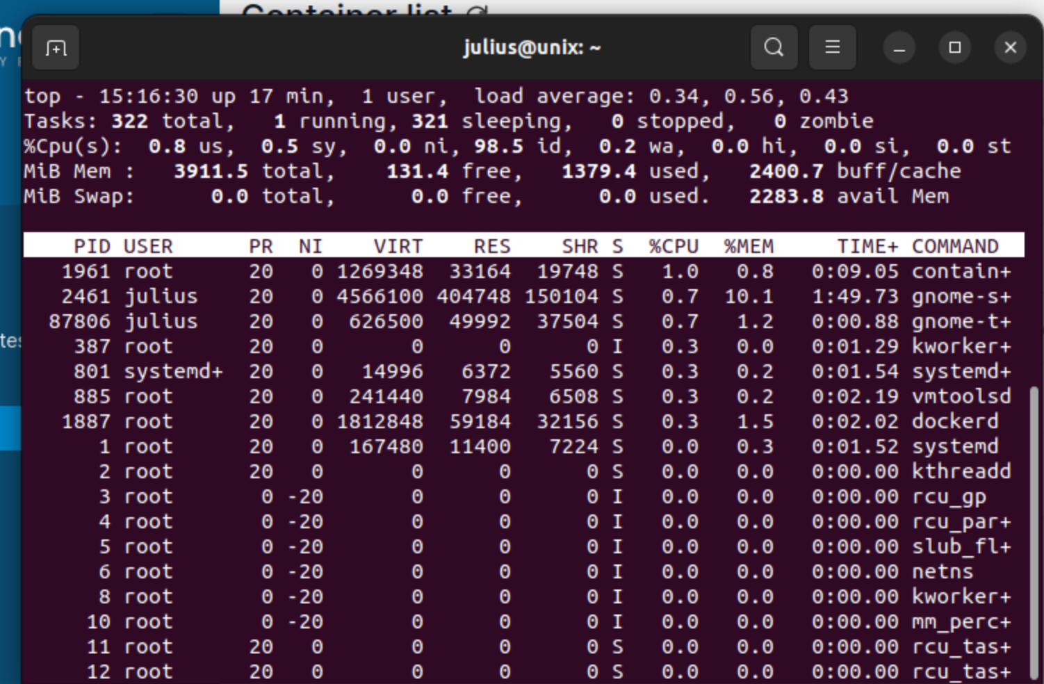
Správa procov
top – display sorted information about processes

Slide 20
Správa procesov
bg - spustenie procesu na pozadí
fg – prenesenie procesu do popredia, Za príkaz môžeme zadať PID procesu po percente alebo ho spustiť bez parametrov, kedy prenesie do popredia posledný pozastavený proces alebo posledný proces v pozadí
Nohup - short for no hang up is a command in Linux systems that keep processes running even after exiting the shell or terminal.

Slide 21
Questions?

